Slide 1
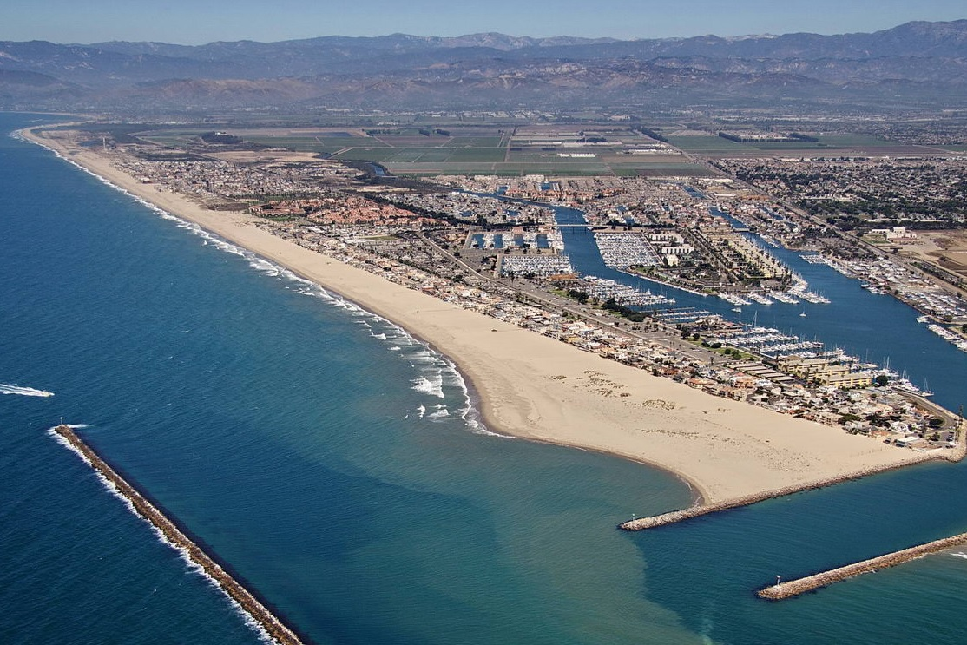
What’s the problem?

Slide 2
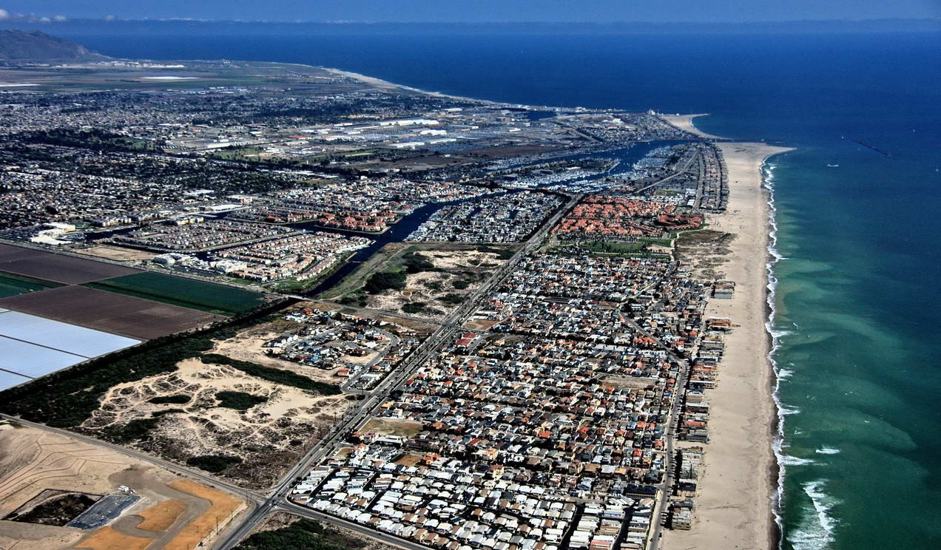

Slide 3
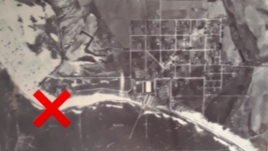
Pre - Port of Hueneme

Slide 4
Lack of sand Emergency 2013

Slide 5
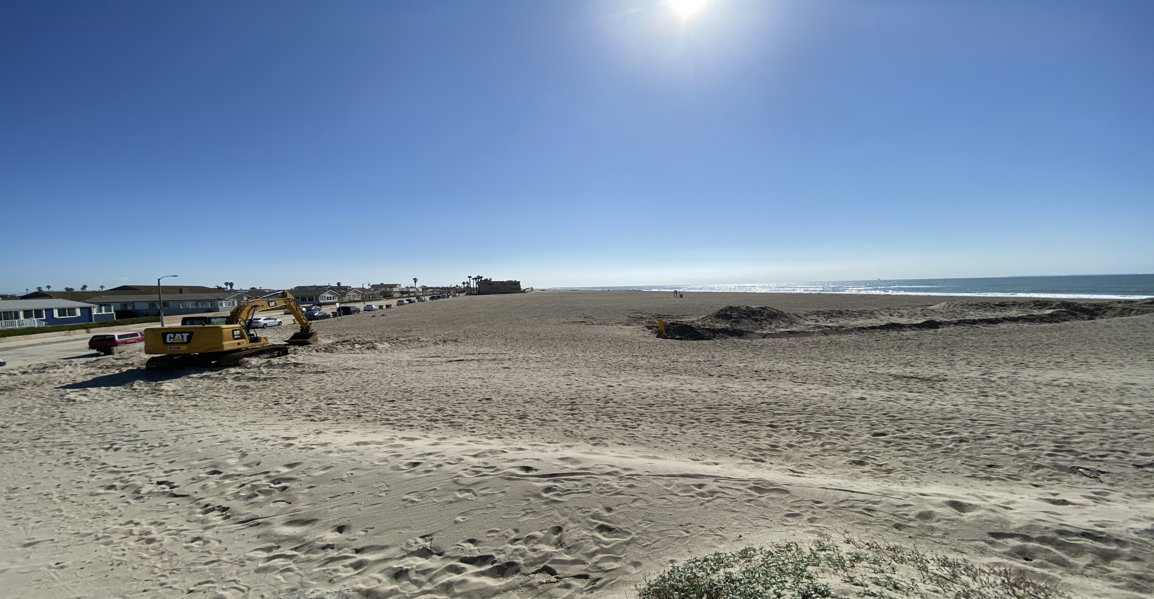
Oxnard Shores - Plenty of Sand

Slide 6
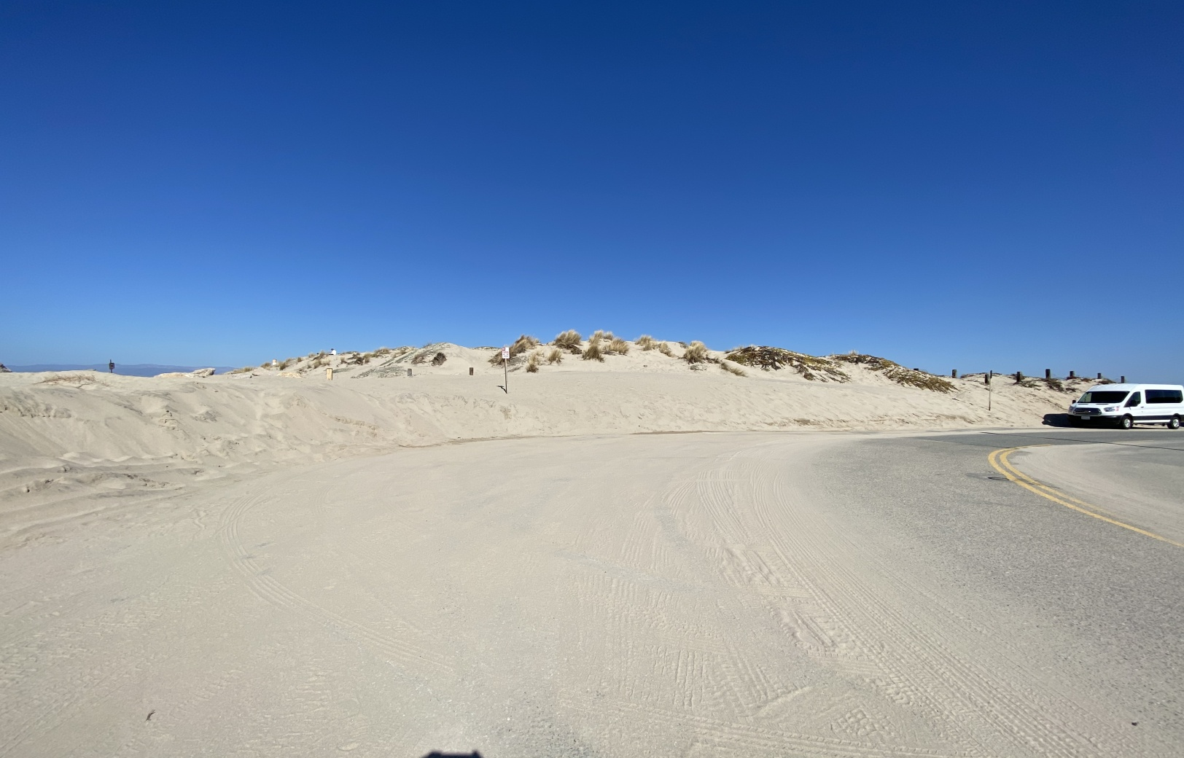
Road / Sand Creates Risk

Slide 7
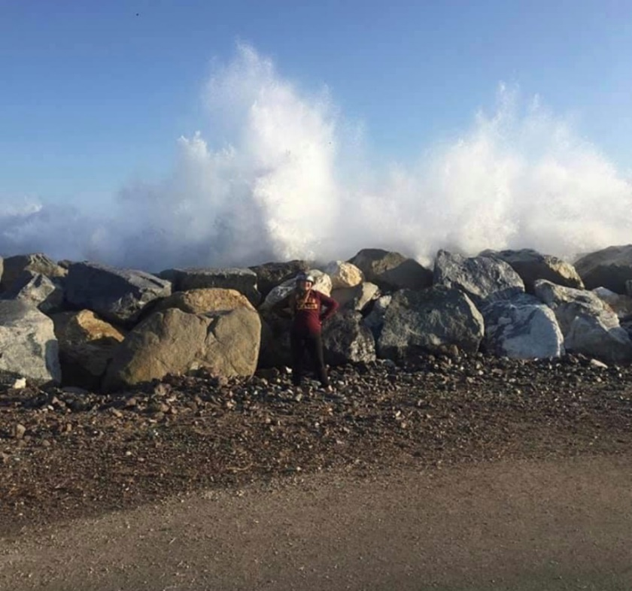
Not Designed for Direct Wave Impact

Slide 8
Picnic Areas Lost 2012/13

Slide 9
October 28, 2013

Slide 10
Surfside Drive - Emergency 2013

Slide 11
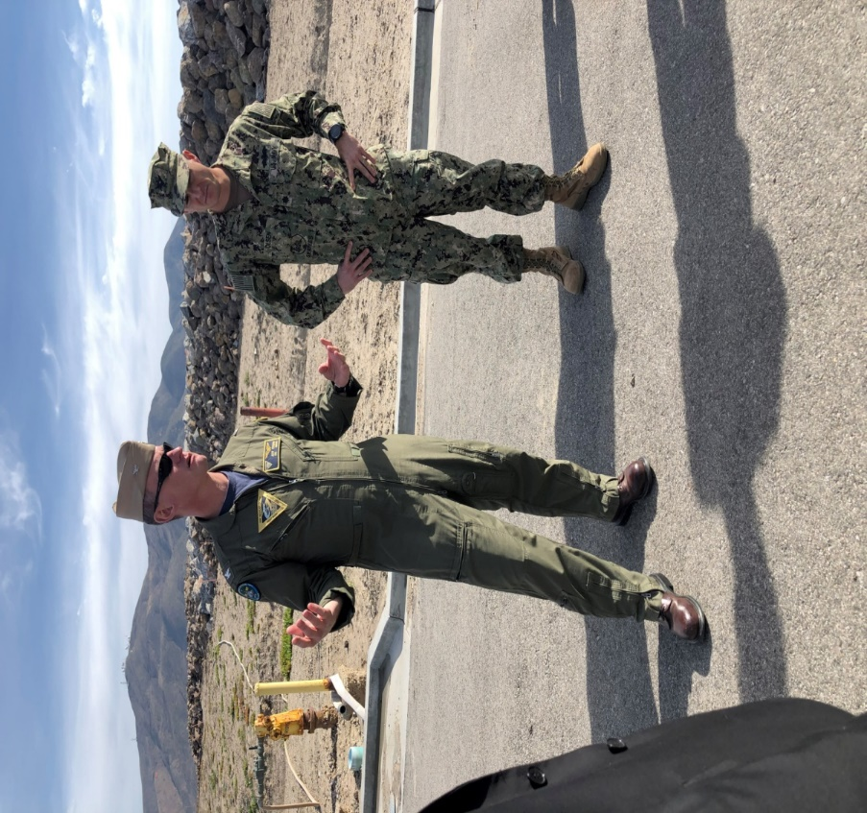
Point Mugu Rock Revetment

Slide 12
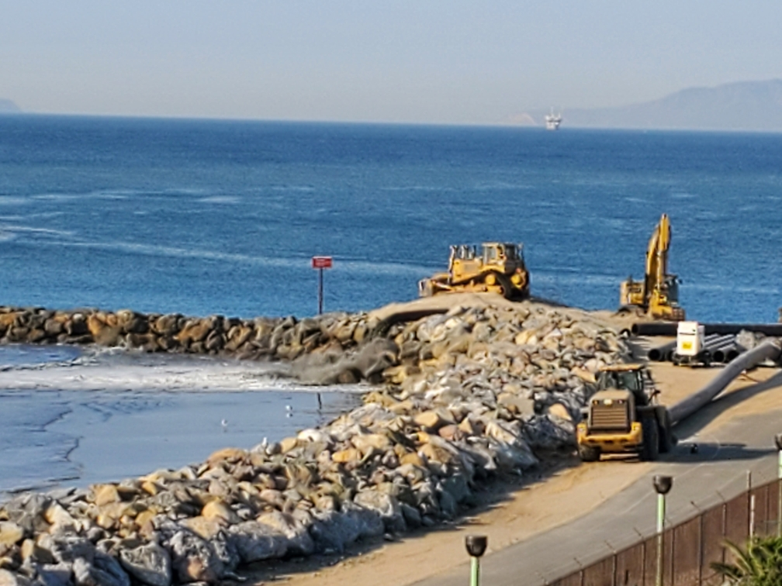
Day 2 - 2021 Dredge Cycle

Slide 13
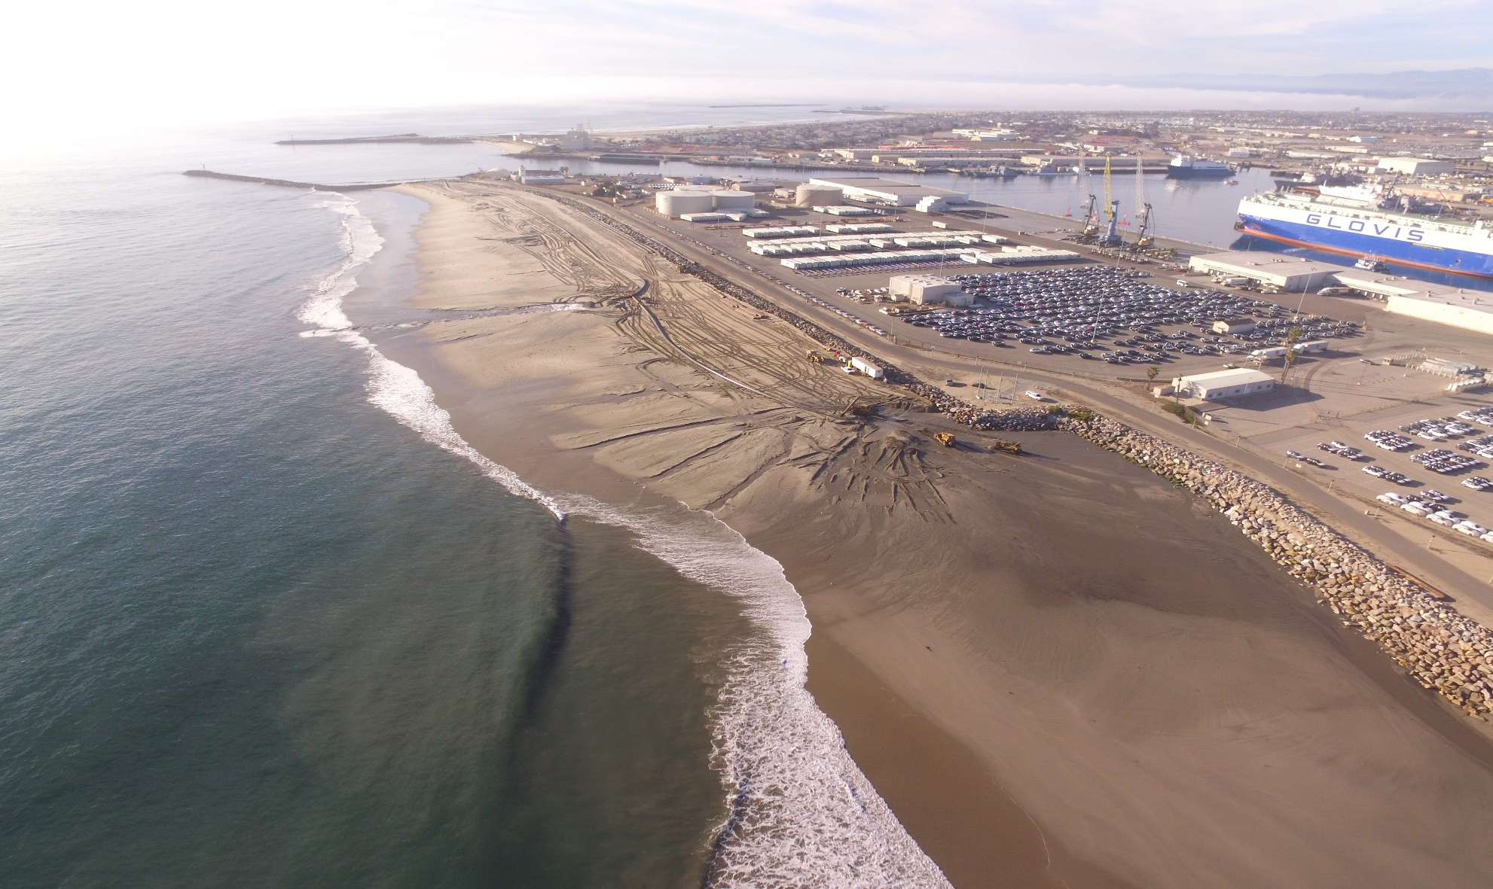
1,000,000 Cubic Yards

Slide 14
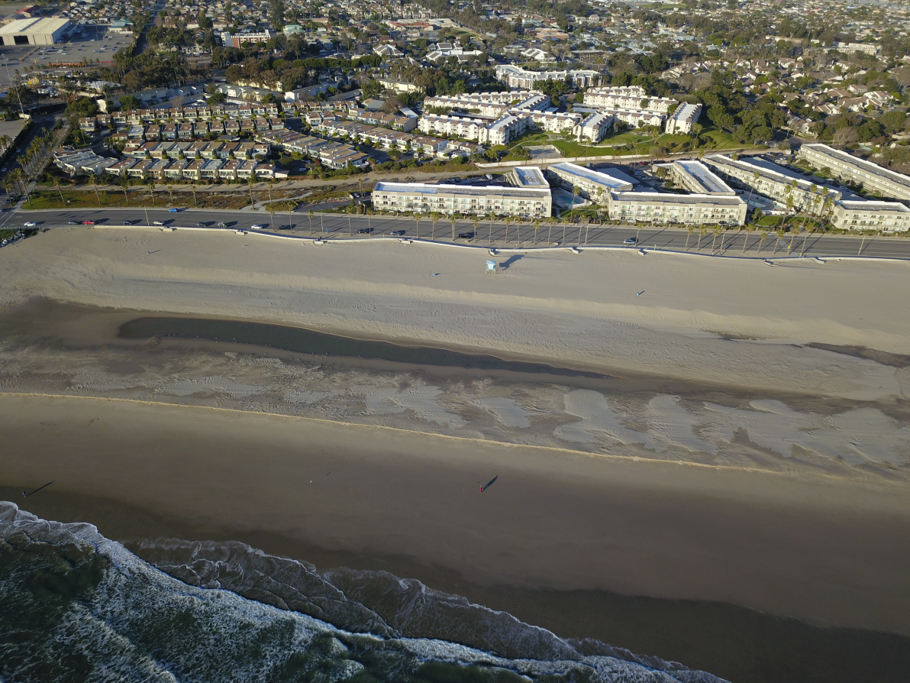
February 2021 – Sand Scar

Slide 15
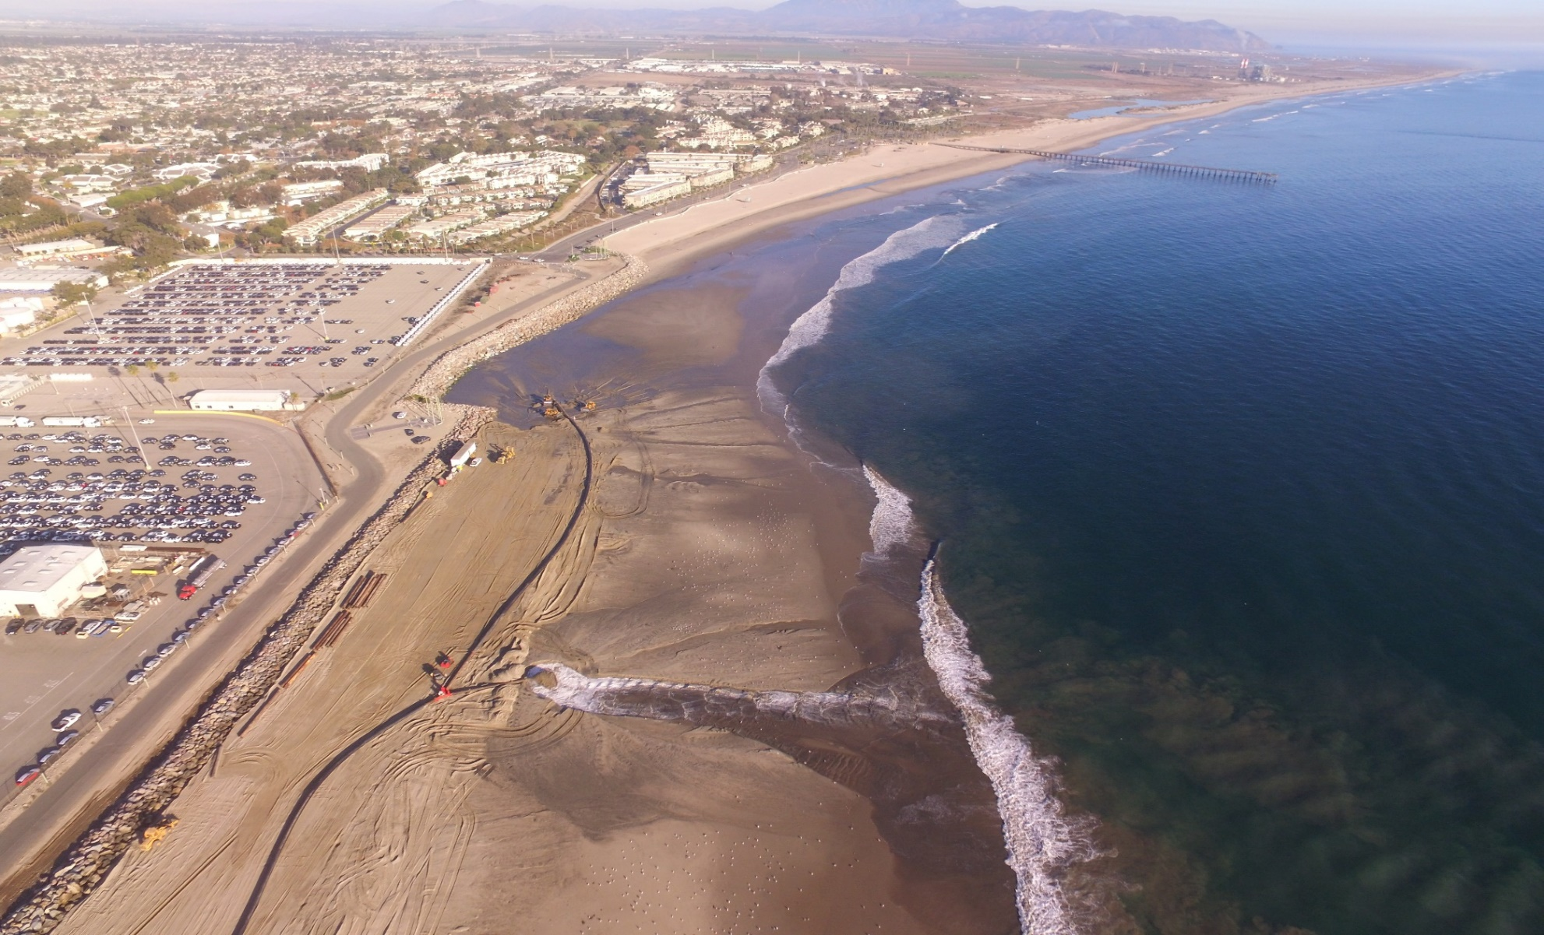
December 2020

Slide 16
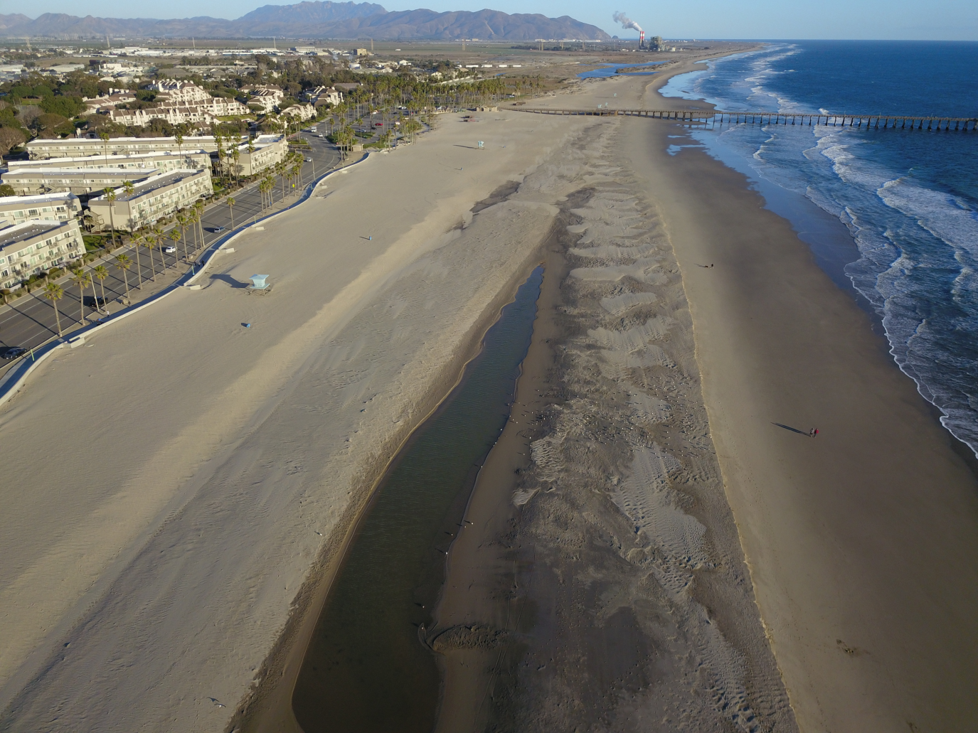
January 2021

Slide 17
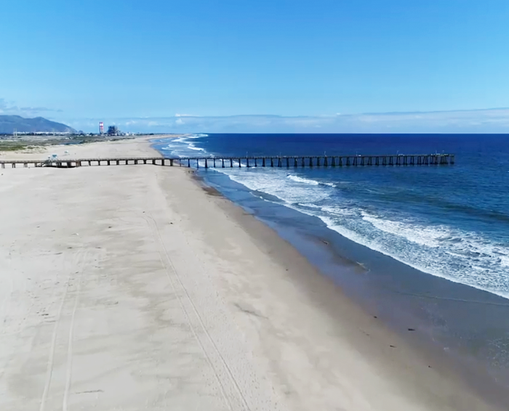

Slide 18
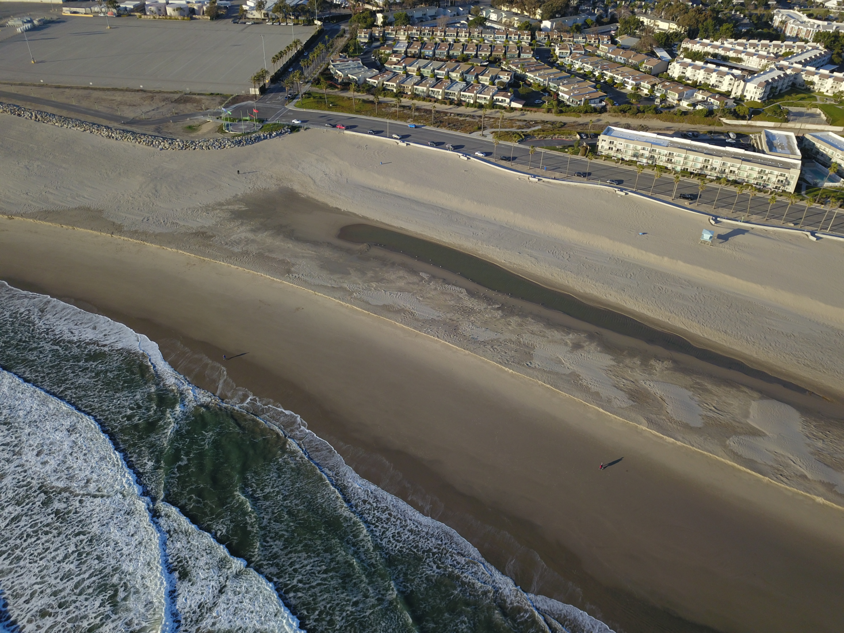

Slide 19
Near Shore Sand Deposit

Slide 20
Clam Shell Deepening

Slide 21
Dredge Cycle Completed February 2021

Slide 22
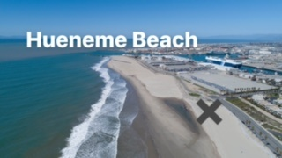
Dredge Cycle Completed March 2019

